Slide 1


www.communityinclusion.org
Online Learning:
Addressing the Needs of All Students

Slide 2

Today’s Webinar: Topics
Universal Design and Universal Design for Learning
Legal requirements for accessibility
Basic strategies for online learning

Slide 3

Webinar # 2
Student access & competency with technology
Maximizing universal access in online platforms
Ensuring materials used online are fully accessible

Slide 4

Webinar # 3
Review and demonstration of a variety of a variety of tools to support students in online learning
Criteria for determining best tools for content and learner needs.

Slide 5

Discussion:
What do we mean by
“online learning”?
Courses taught live online
Pre-recorded course content
Self-paced online learning platforms

Slide 6

Poll # 1:
What platforms are you using for online learning?

Slide 7

Poll # 2:
What issues have you encountered regarding delivering content online?

Slide 8

Strengths of Online Learning
Increased student access
Reduced facility costs
Use of online platform tools
Others

Slide 9

Issues with Online Learning
Access to technology
Skills in using technology
Reliability of technology
Maintaining student engagement
Monitoring student engagement
Challenge of peer-to-peer learning
Challenge of hands-on learning
Challenge of assessment/testing
Other

Slide 10

Discussion
What questions do you have regarding specifically meeting the needs of students with disabilities in online courses?

Slide 11
Core Strategy:
Universal Design

Slide 12


Slide 13

Universal Design
Create environments that are usable by as many people as possible regardless of their age, size, ability, or disability

Slide 14
Incorporating Universal Design
Design environment to meet needs of all people who wish to use it
Flexibility in use – not “one size fits all”
Meeting needs of people with disabilities is no longer considered “Special” or “Extra”
Universal Design is Good Design

Slide 15
Universal Design
Universal Design for Learning

Slide 16


Principles of Universal Design for Learning
I. Provide Multiple Means of Engagement
II. Provide Multiple Means of Representation
III. Provide Multiple Means of Action & Expression

Slide 17
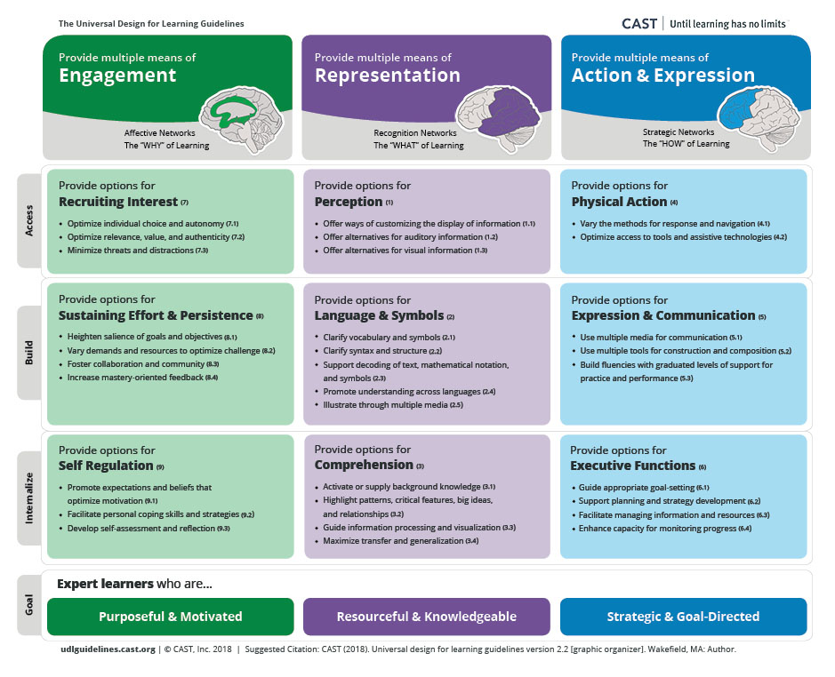
UDL Guidelines
udlguidelines.cast.org

Slide 18

Cultural relevance as part of UDL
Make materials, exercises, examples, and assignments relevant to learner’s cultures, interests, and backgrounds
Words and images

Slide 19


Achieving UDL is a never-ending journey

Slide 20
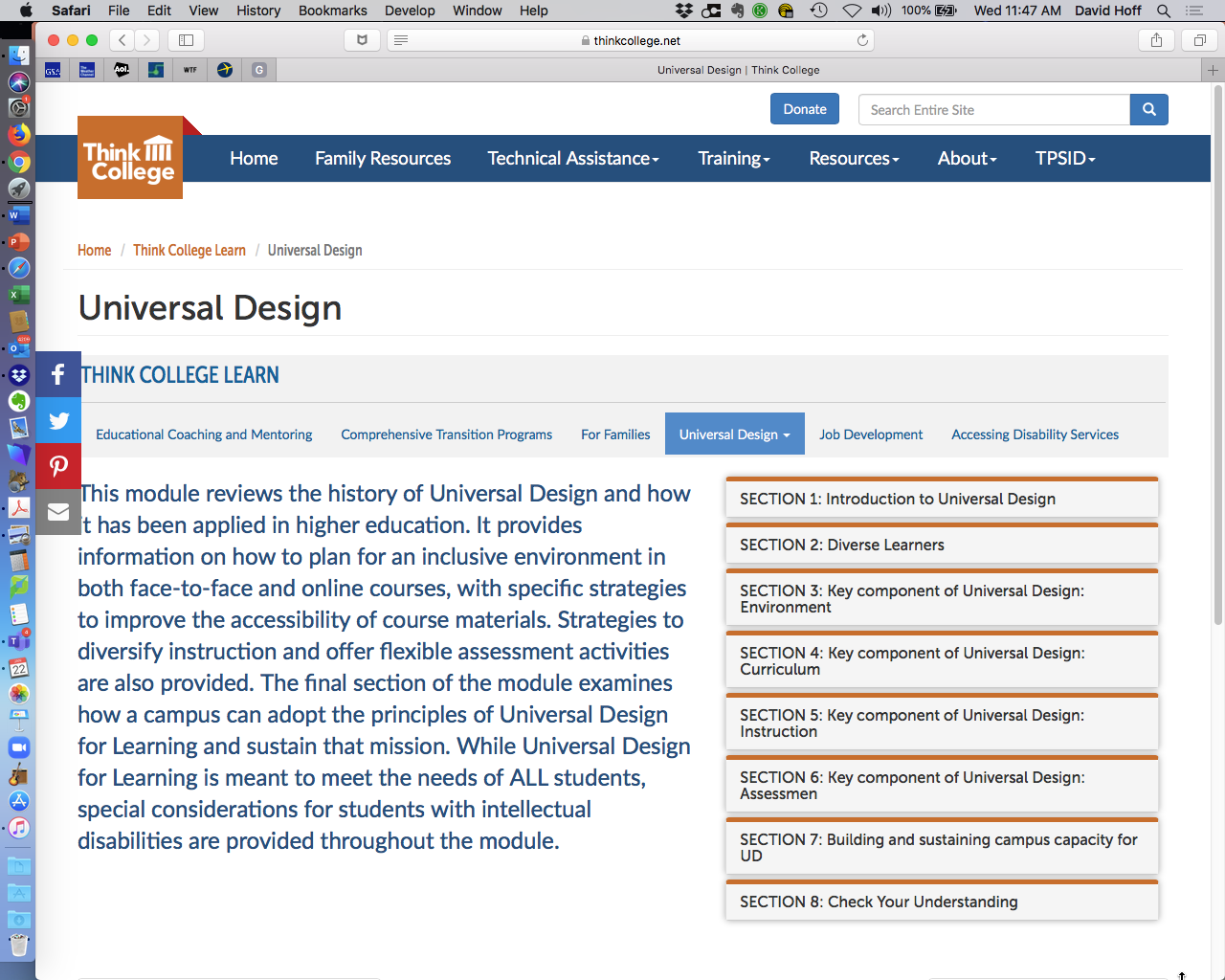

https://thinkcollege.net/think-college-learn/universal-design

Slide 21


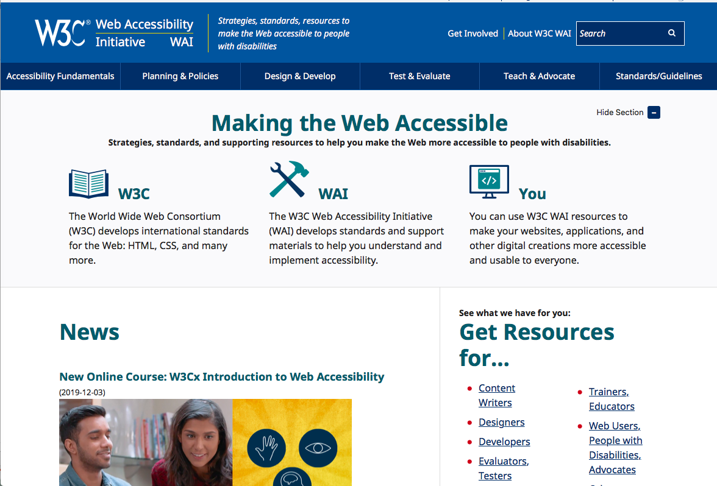
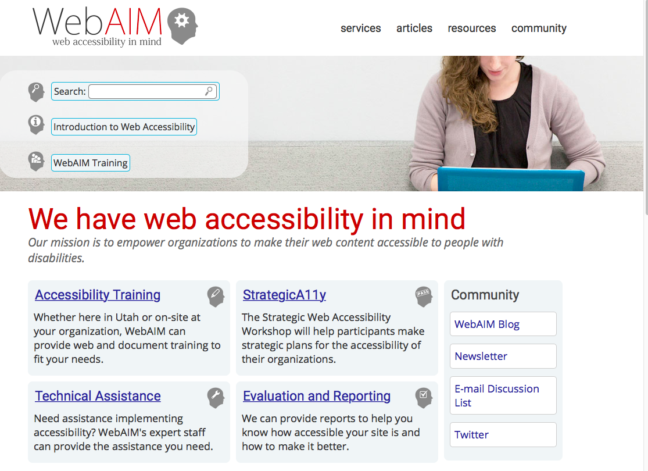
UD Resources

Slide 22
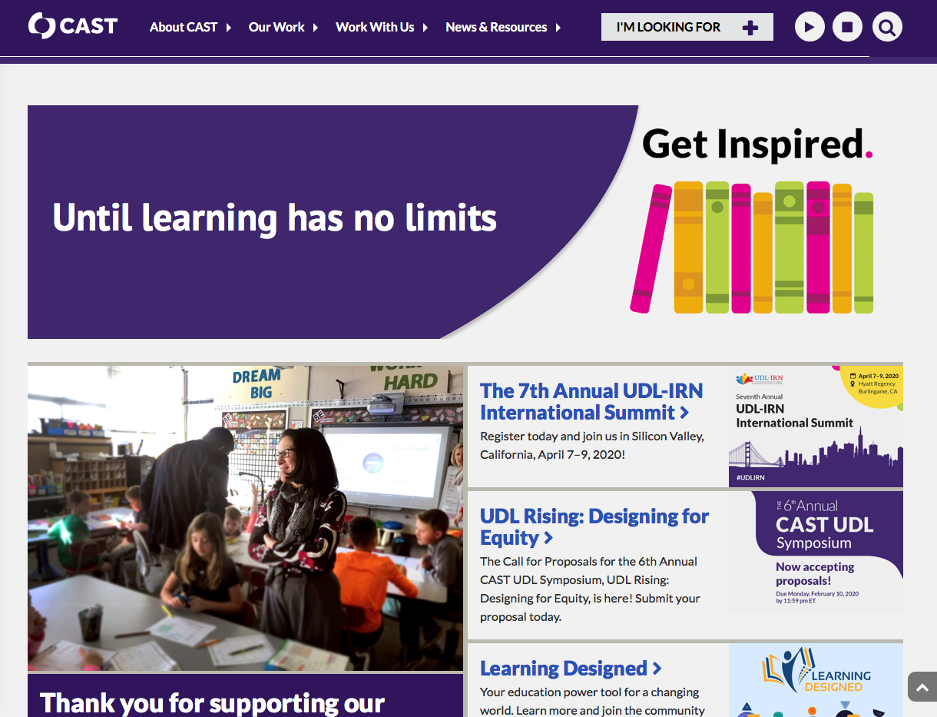
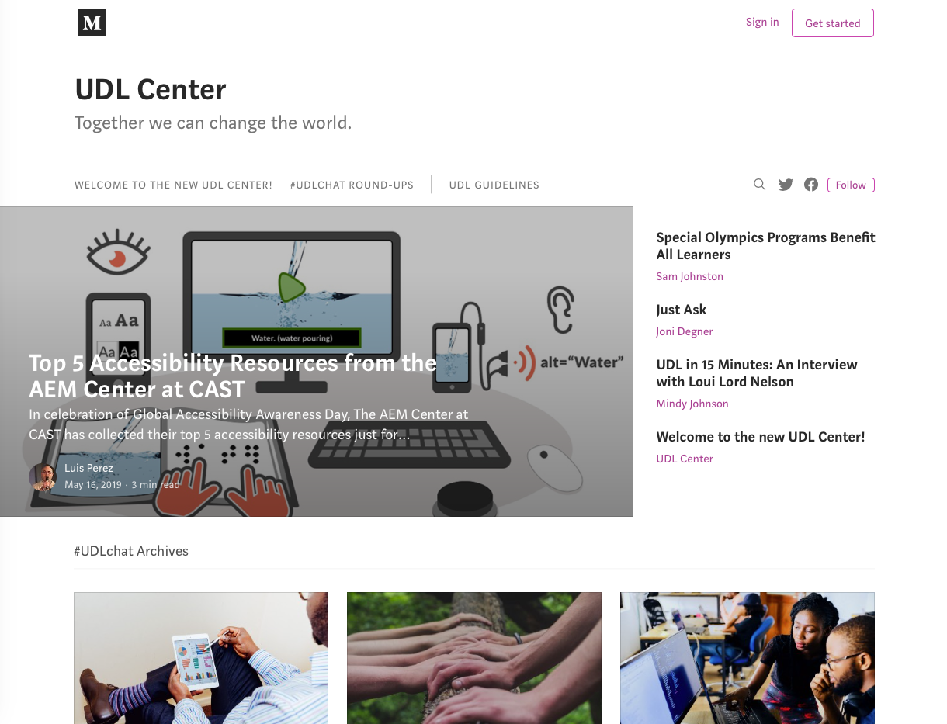
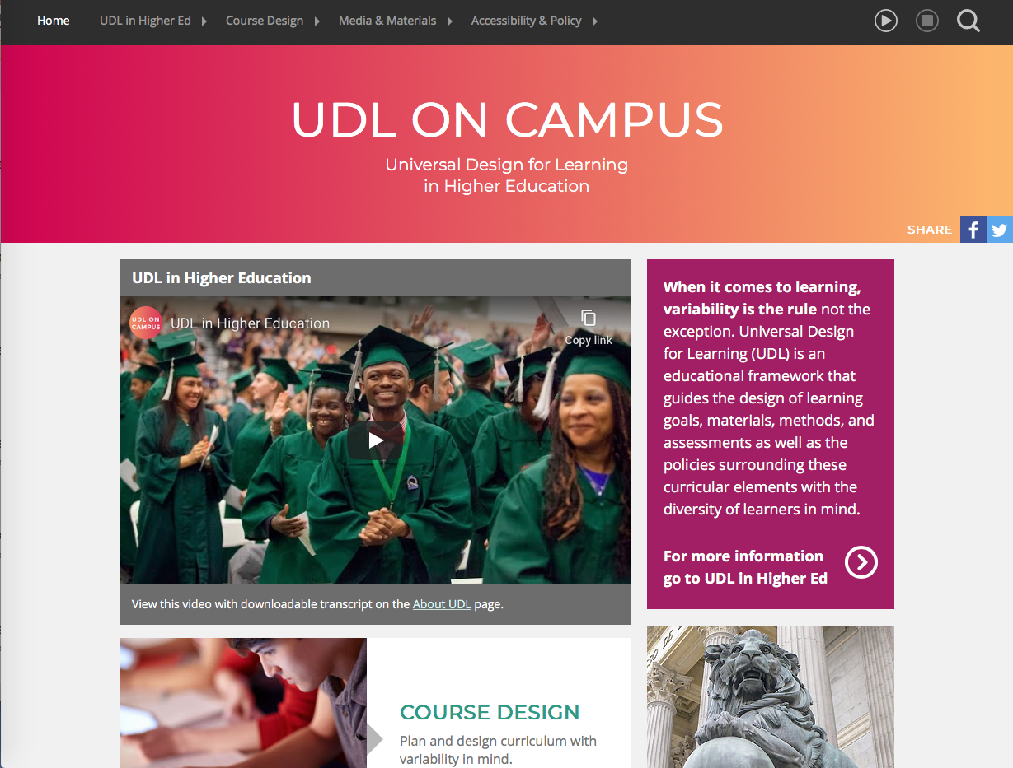
UDL
Resources

Slide 23
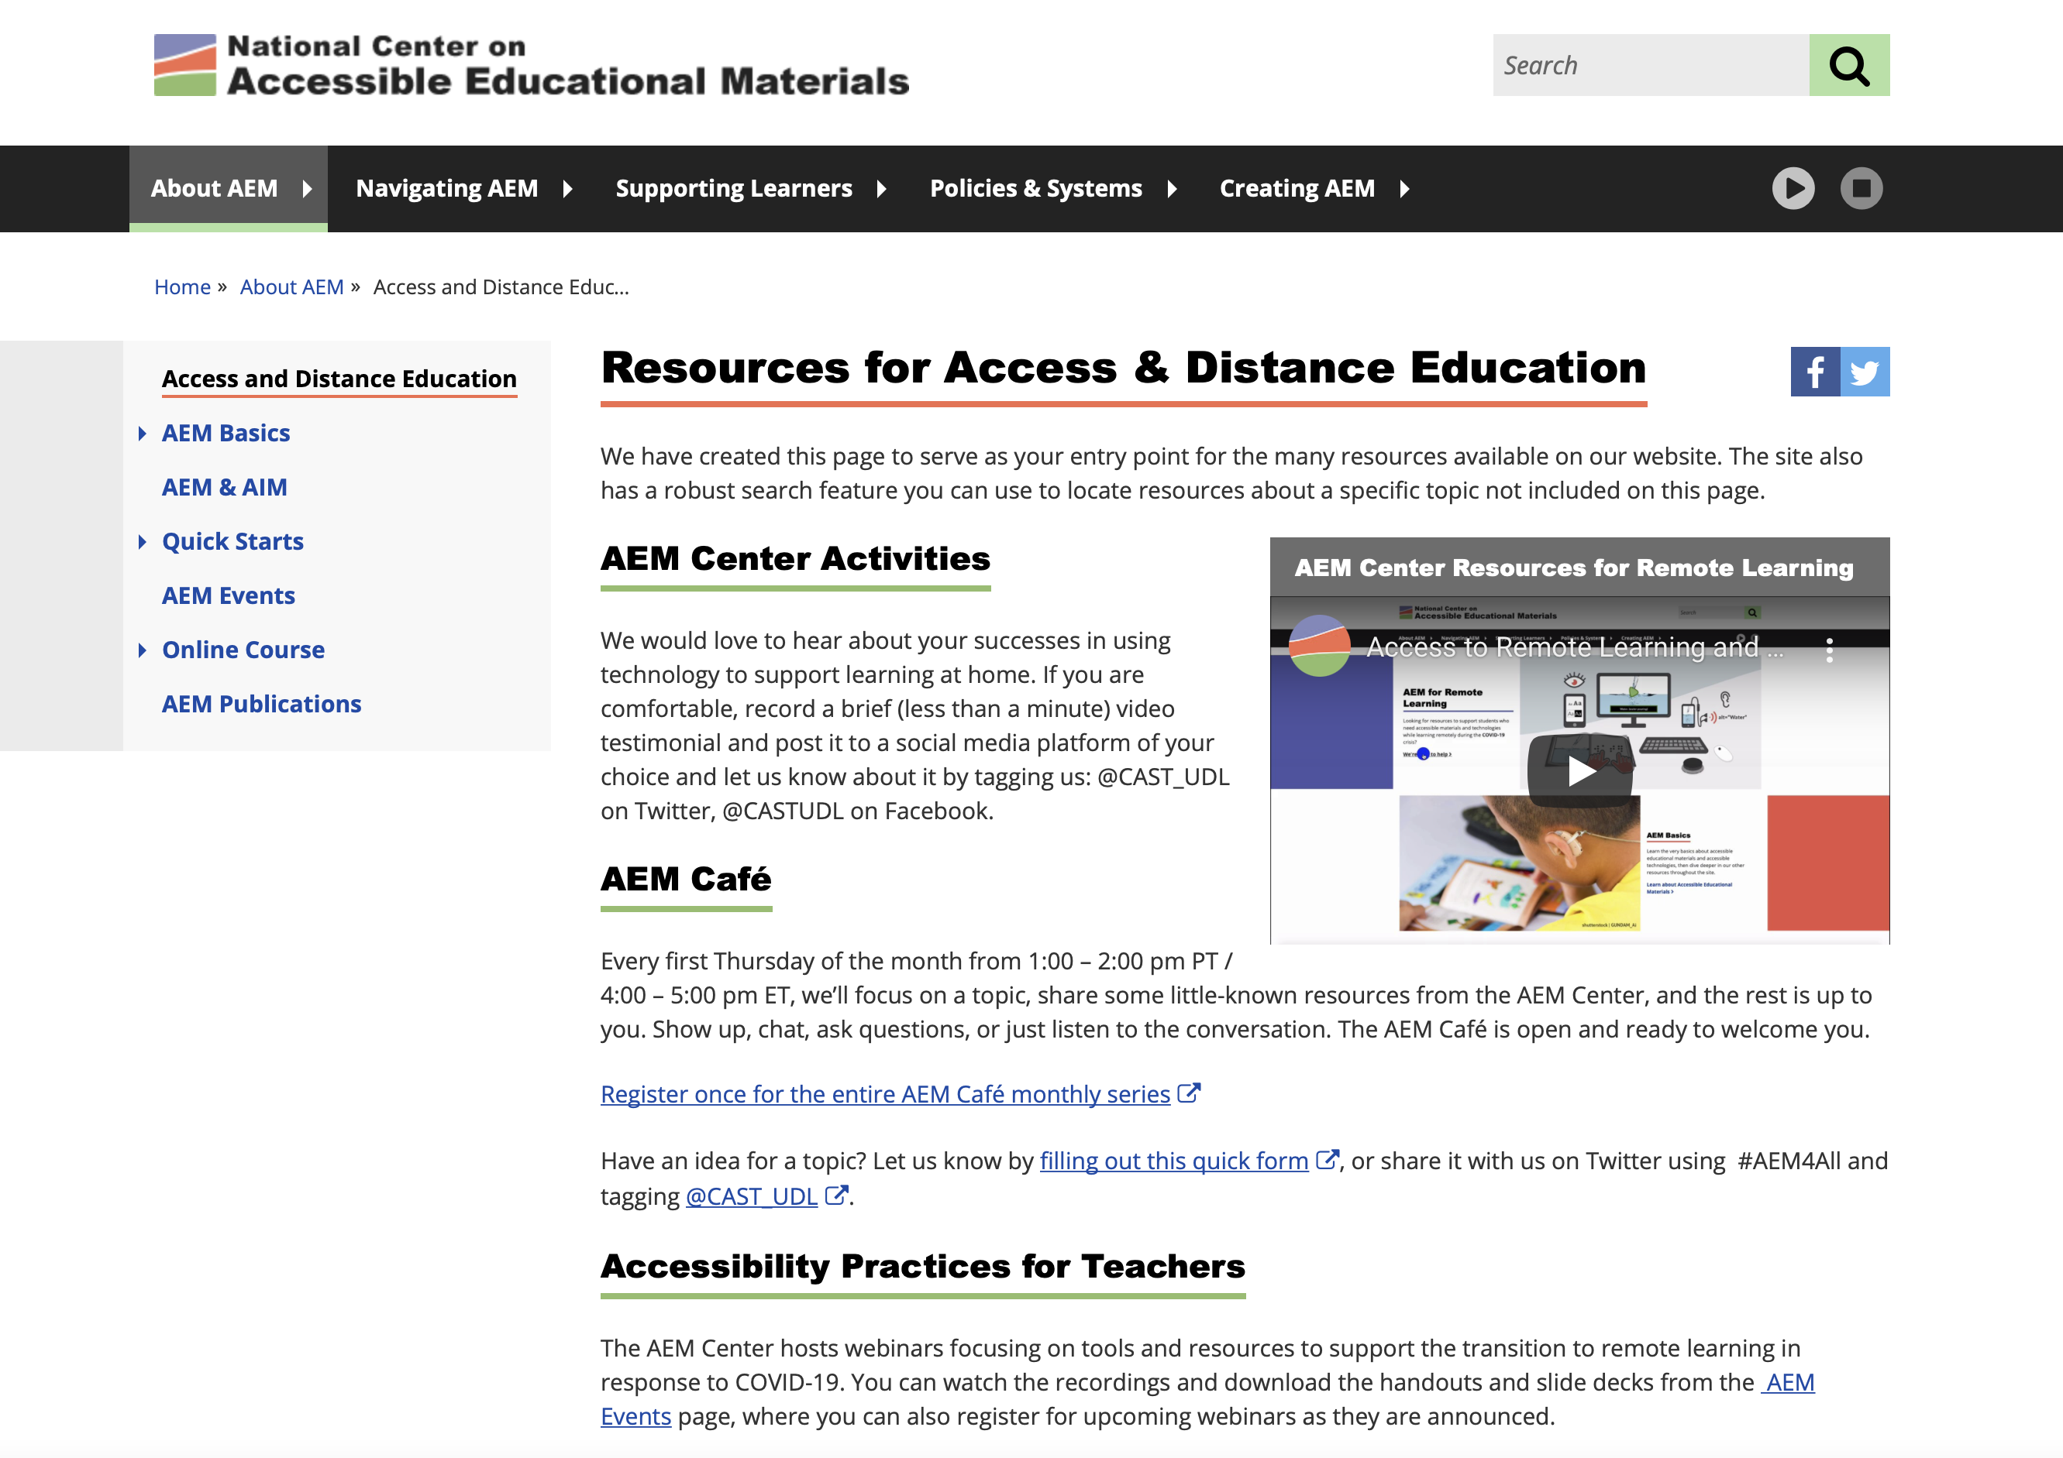
https://aem.cast.org

Slide 24
Universal Design Resources Handout

Slide 25

Legal Requirements and Accommodations

Slide 26
Legal protections for students with disabilities
Americans with Disabilities Act (ADA):
applies to any program receiving state or local funds
Section 504 of the Rehabilitation Act:
applies to any program receiving federal funds
Requirements are virtually
the same under both

Slide 27
Disability
as defined by the ADA
A physical or mental impairment that substantially limits one or more major life activities
A record of such an impairment
Being regarded as having such an impairment, even when no limitations exist

Slide 28

What is accessible?
An individual with a disability is allowed to:
  receive same information
  participate in same interactions
  have same services
as a person without a disability
Participation is carried out in equal and integrative ways

Slide 29
Reasonable Accommodations
Any adjustment or altering of a task, process, or environment that will allow equal participation for individuals with disabilities
Must be provided to a qualified individual with a disability unless program can demonstrate that the accommodation would impose an ”undue hardship” or substantially alter nature of the program

Slide 30
Implications for Adult Education Programs
May not discriminate against individuals with disabilities regarding:
  Eligibility and admission
  Providing instruction and other services
Must be both proactive and reactive
  PROACTIVE: Programs must be accessible and barrier free
  REACTIVE: Must offer reasonable accommodations that will assist individuals with disabilities to have an equal opportunity to participate

Slide 31

ADA Standards for Adult and Community Learning Services
Must have an ADA Coordinator
Post public notice of
non-discrimination
Establish and publish a written grievance procedure
Must conduct a one-time self-evaluation on accessibility
Must have a transition plan for removal of any physical barriers

Slide 32
Proactive Approach to Accessibility
Emphasize goal of meeting needs of all learners and full accessibility for all
Universal awareness of right to accommodation and how to request
Accommodation request procedures: simple, clear, emphasis on privacy
Provide name and contact for ADA Coordinator
Include information in:
  Course information & registration materials
  Syllabus
  Orientation
  First class

Slide 33

Reasonable Accommodations in Adult Education

Slide 34
Dealing with accommodation requests
Contact ADA coordinator
Discuss in private
Use a functional approach:
    What does the student need help with?
    What are possible solutions?
    What has student previously used for accommodations in similar situations?
Document using a standard format
Don’t presume
Consult with external resources as necessary
Evaluate and modify accommodation as necessary

Slide 35

If needing an accommodation:
  Identifying themselves as having a disability
  Providing documentation regarding their disability and need for accommodation
  Requesting accommodation in a timely fashion

Slide 36

Discussion

Slide 37
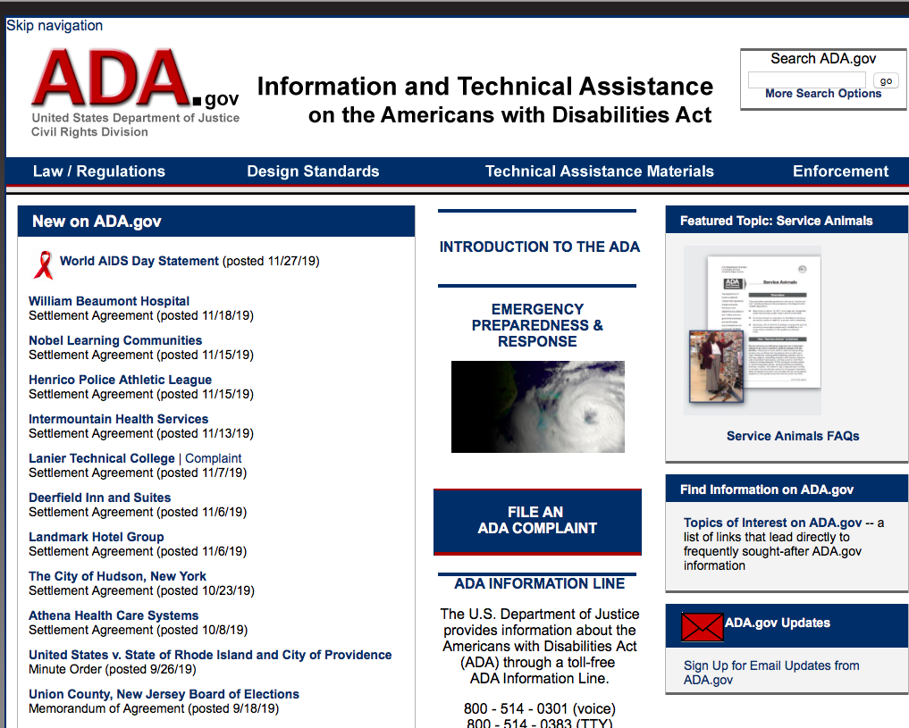
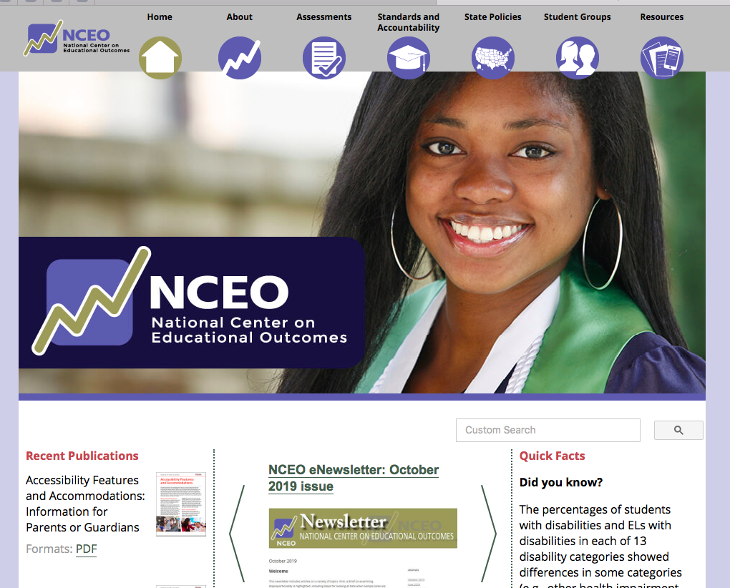
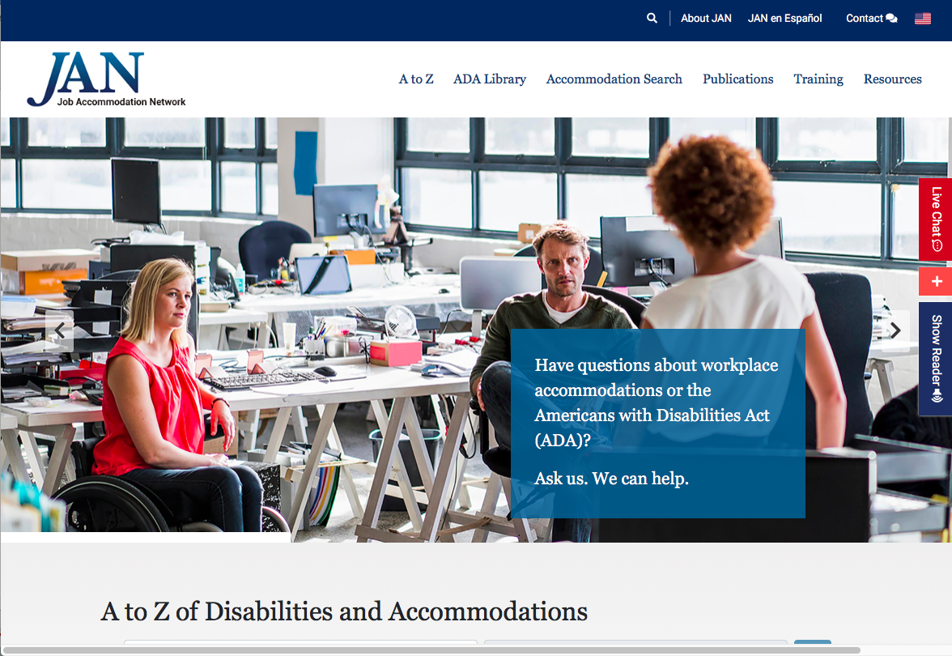
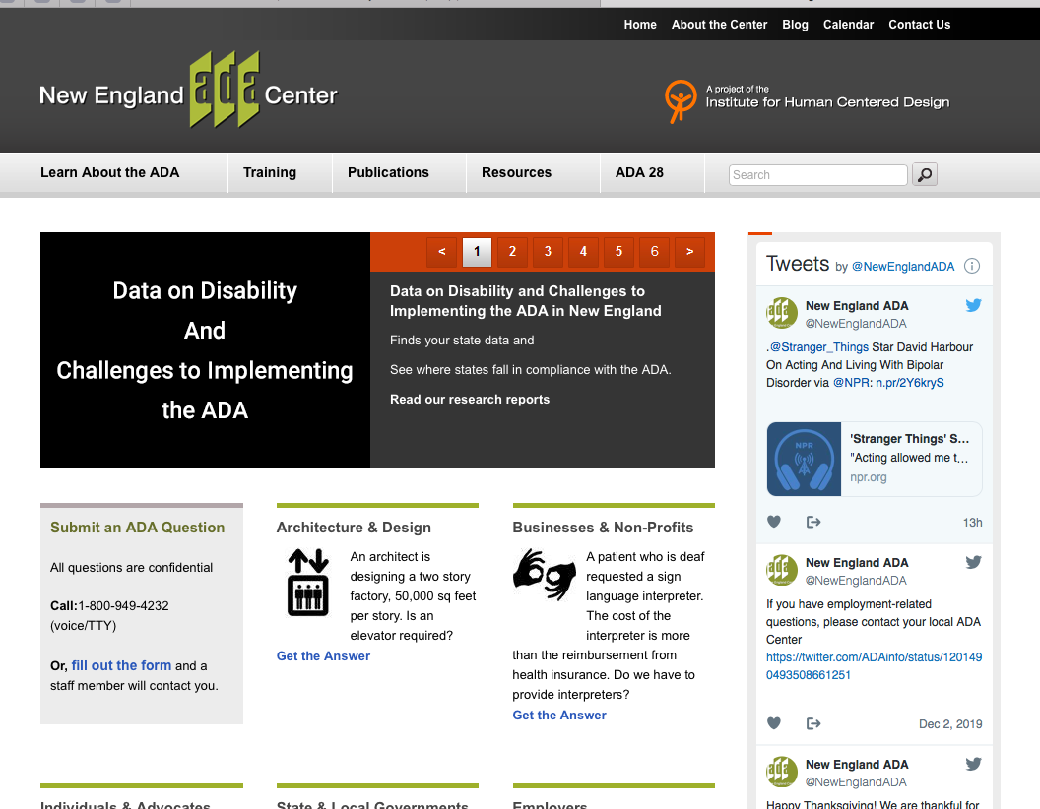
ADA & Accessibility Resources

Slide 38
Strategies

Slide 39
Individualized Student-Centered Approach
Ask student how they best learn and learning preferences
Previous experience in online learning: successes and challenges
What tools and strategies have worked best for them
Supports needed to succeed
Have student develop list of which online learning strategies best support their strengths and needs
Partner with student to co-create strategies for online learning

Slide 40
Ongoing feedback & evaluation
Get ongoing feedback from students about your virtual instruction: what’s working, areas for improvement
Use surveys, rubrics, or journaling to give students chance to assess their own learning and provide feedback

Slide 41

Basics of Online Classes
Review technology features at beginning of each lesson
Empower students to customize to individual needs
  Video: on or off?
Use variety of methods for presenting/learning/engagement
  Slides
  Video
  Websites
  Polls
  Breakout rooms
Have visuals on-screen only as necessary
Provide breaks

Slide 42

Discussion
Ideas for maintaining ongoing engagement online employing principles of UDL

Slide 43


Questions, Comments

Slide 44




